Slide 1
Response and Recovery through Event Portfolio Management: A Case Study from Des Moines, Iowa
Smita Singh, Ph.D. Candidate, Iowa State University
Dr. Eric D. Olson, Associate Professor, Iowa State University

Slide 2
Introduction
Des Moines, Iowa is the capital and most populous city in Iowa. Employers and people are attracted to live and work in Des Moines due to its strong job market, low cost of living, strong schools, and high quality of life.
This chapter utilizes the festival and event sector in Des Moines, Iowa as a case study to highlight the challenges of recovery and response to the COVID-19 pandemic.
This chapter examines how Des Moines’s portfolio management of festivals and events will position the city for a strong recovery in the festival and event sector.

Slide 3
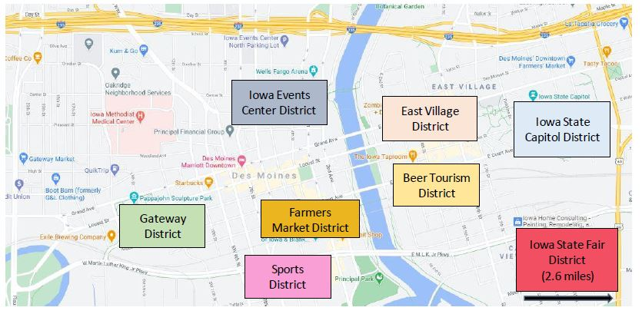
Key Festivals and Events in Des Moines
Business events, expos, live music events, sports and other kinds of events
Capital City Pride
Retail Events
Political Events
Downtown Farmers’ Market
Iowa State Fair
Des Moines Arts festival; Celebr Asian Heritage Festival; World Food and Music Festival; 80/35 music festival
Iowa Clubs sport events; wedding expo
Beer-related events
Figure 1. Map of Festival and Event Districts in Des Moines. Retrieved from Google (n.d.). Des Moines. https://www.google.com/maps/@41.5877507,-93.623323,15.25z. Names of districts have been added by authors.

Slide 4
The Impact of COVID-19
On March 15, 2020, Des Moines declared a state of emergency.
The pandemic has disrupted event ticket sales, volunteers, and community sponsorships.
The cancelation and delay of conventions and sporting events resulted in a revenue loss of more than $35 million.
The Iowa State Fair was canceled for the first time since World War II, which resulted in an estimated loss of $30 million in revenues.
Numerous independent music venues, including Vaudeville Mews in Des Moines, closed during the pandemic.
Wooly’s an independent music venue in the East Village neighborhood in Des Moines was reopened with a reduced capacity.

Slide 5
How Des Moines Events Have Adapted
The DSM Book Festival, offered a “fee within a fee” concept and provided enhanced workshops and seating for limited VIP passes.
Des Moines’ Downtown Farmers’ Market created a drive-through option, i.e., the Drive-Through Bite-Size Market, for its customers, in which participating vendors were featured online. The customers were able to pre-order goods by going online and picking them up from their vehicles at the Drive-Through Bite-Size Market on the assigned days.
The Iowa Food & Music Festival was repositioned as a “community-wide celebration of food, music, heritage and culture” and embraced a Community Cookout and encouraged Des Moines residents to decorate driveways and balconies by hosting a “mini-World Food & Music Festival” by cooking global dishes. It also maintained a retail website where visitors could purchase festival-themed apparel, stickers & koozies, and other merchandise items.

Slide 6
Portfolio Management in Des Moines
Events and festivals in Des Moines have long been supported by the community and volunteers, along with financial support through stakeholders like Catch Des Moines, City of Des Moines, Bravo Greater Des Moines, and Greater Des Moines Partnership.
Portfolio Stakeholder | Organization Mission | Event Strategy and Goals | Funding of Events and Festivals | Ownership of Events and Festivals | COVID-19 Event Recovery & Response
City of Des Moines | To promote economic and community development | Events used to enhance quality of life; oversees collection of taxes and street closer fees | Minimal funding of events and festivals | No ownership of events and festivals | Currently focused on COVID-19 response of city; safety and wellness of Des Moines citizens
Catch Des Moines | To market the Des Moines region as a visitor destination to increase economic growth and enhance the visitor experience. | Events enhance economic success and the quality of life | Funding is obtained from local accommodation tax | No ownership of events and festivals | Marketing and communication of programs, events, reopening resources
Bravo Greater Des Moines | To elevate and enrich a vibrant Greater Des Moines through arts, culture, and heritage | Event strengthen the arts, culture, and heritage in central Iowa | Funded by hotel/motel tax revenues contributed local government partners | Provides financial support and leadership support for arts, culture, and heritage of Des Moines Hosts fundraising and awards events | Funding has decreased from hotel/motel tax
Greater Des Moines Partnership | To drive economic growth through one voice, one mission and one region | Events can help in promoting businesses, career, and future of Des Moines area | Funds events through global collaboration with affiliate chambers of commerce, regional business members and investors | Numerous events including DSM Book Festival, Downtown Des Moines Farmers’ Market, World Food & Music Festival, Holiday Promenade, and others | Created Rapid Response Hub with resources pertaining to small businesses, employment, government and public policy
Independent Events | To support independent events and festivals. | Entrepreneurial in nature; for-profit viewpoint | May receive funds from hotel tax | Variety of independent events | Recovery and response strategies

Slide 7
Tactics to Overcome Challenges
Create Umbrella Organization to Foster Collaboration
A larger organization in Des Moines, made up of industry leaders, government officials, event and festival suppliers, and educational programs could be utilized to share best practices, build partnerships, and advocate for the industry. Formal education, networking events, and informal training could also cultivate relationships in the industry.
City of Des Moines’ Role in Post-
COVID-19
The city of Des Moines may also create a toolkit on best practices for operating events and festivals. The city should also continue to be an advocate of bringing festivals and events to its downtown area. For example, in previous years, the Des Moines Arts Festival used to be held at Des Moines Arts Center (approximately four miles from downtown Des Moines).
Collaborations with educational institutions should provide educational opportunities for students, including internships, jobs, and other educational experiences for students as well as content experts for industry panels and advisory boards, building the bridge between academia and industry. Faculty at these institutions should embrace to provide educational content in “retooling” industry practitioners who may have been recently furloughed or those interested in getting into the event management field.
Partner with Local Education Programs
The festival and event industry professionals in Des Moines have the brand, the audience, the expertise and know-how, and the social inclusion elements to assist the city in meeting its objectives in COVID-19 testing and recovery. Many festival and event spaces are used to facilitate public health initiatives.
Use Event Managers in City Planning

